Slide 1
PlutoMake
Photo-realistic previews

Slide 2
The Problem
When clients order products from you with a logo/design, how do you know whether they will like the product without you actually making it?

Slide 3
Our Solution
We take a picture of your product and the client logo, and produce a photo-realistic preview image of what the product would look like in real life if the logo was actually printed on it. You can then use this to show your client to see if they would like that.

Slide 4
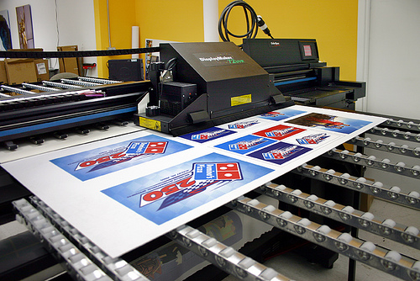

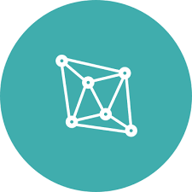
How does it work?
Beforehand, you will provide us with template images of your products.
We use our proprietary computer graphics technology to analyze and process your template images.
PlutoMake
PlutoMake

Slide 5


How does it work?
Client makes an order from you with their logo on one of your products (call it product A).
You then use PlutoMake to generate a preview image.
“I want this logo
on product A”
“Put on Product A”
PlutoMake

Slide 6
How does it work?
We use the data from your template of product A, that we created before, to create the photo-realistic preview.
We send back image to you within seconds, and if you approve, you show the client.
PlutoMake
PlutoMake
Approve?

Slide 7
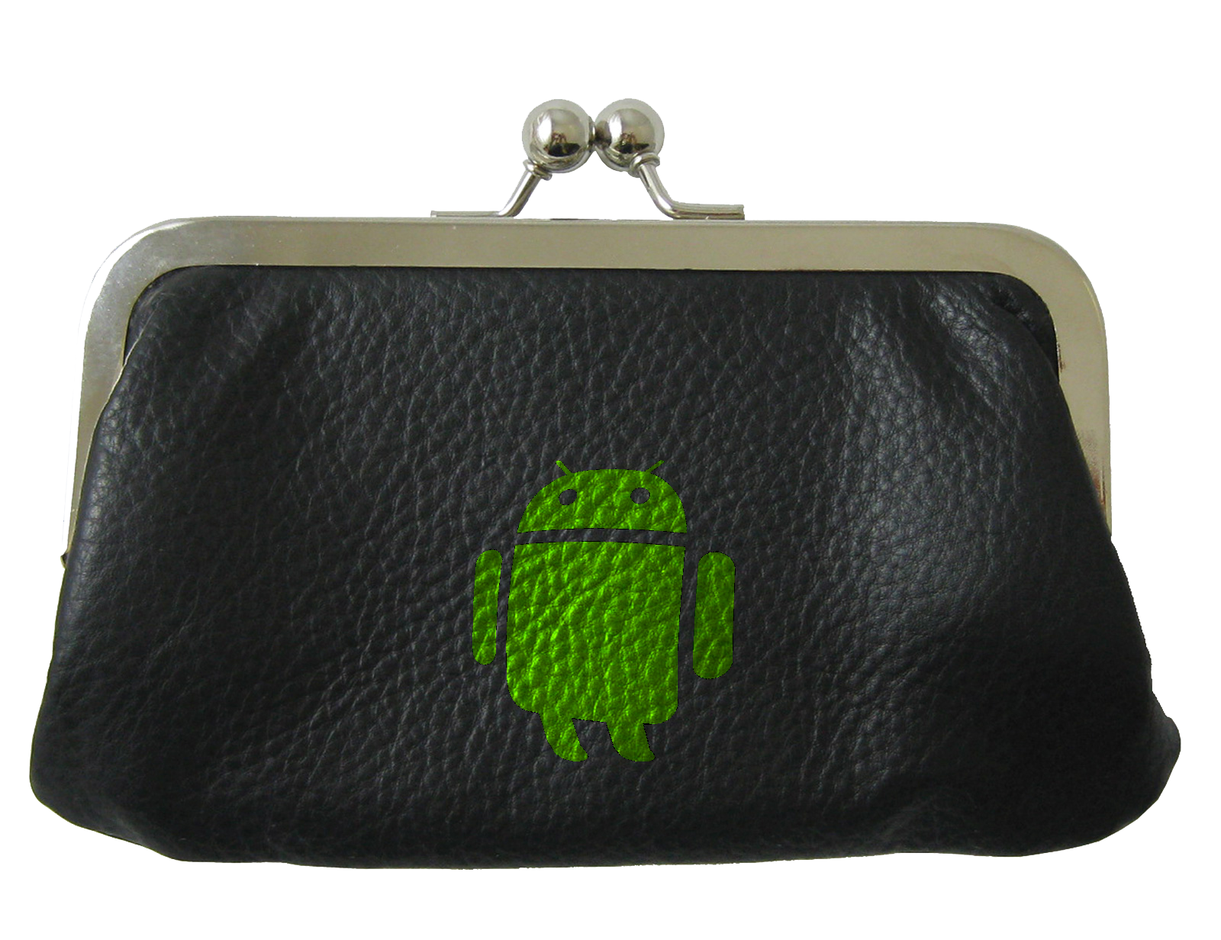

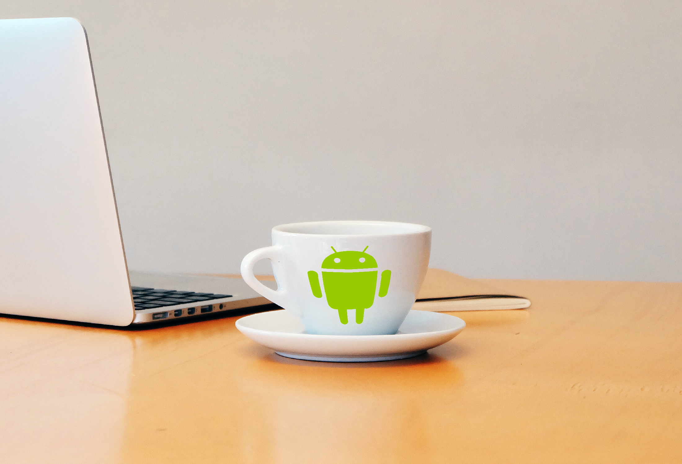
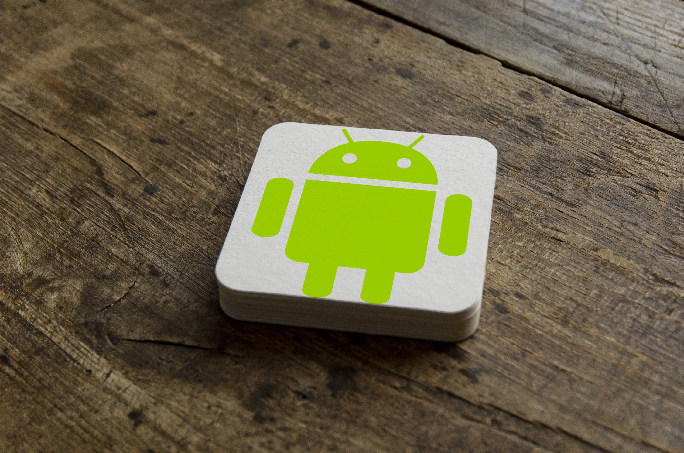
What are some examples?

Slide 8
How much will it cost?
It will be free for a year or two.
We won’t ask for any credit cards.
You may quit at any point.
After the free period, there may be a small and affordable monthly or annual fee.

Slide 9
Are there others doing this?
Yes, there are other sites doing something similar but this is why we would be more appealing to you:
We offer free service for longer time.
We work with the images of your products and not our own templates. This way clients see the previews of products you can make.
Other sites create previews which are simple perspective changes of the logos and typically put them on electronic devices. PlutoMake works with perspective changes as well as distortions/warps/bumps and can be applied to any type of product, not just devices.
Resulting images go through you before reaching the client, so you can always not show the client if you don’t like the result.

